Slide 1


Social Cognition Chapter 3: Attention and Encoding
Rain 2022.3.2

Slide 2
The main question:
In social cognition, what stimuli capture our attention and what information that we encoded?

Slide 3



Components in social cognition
Social perception
Social inference
Social behaviors

Slide 4


Attention & Encoding
Attention: Spotlight
Encoding: Transformation

Slide 5
Contents
Faces: The focus of social attention
Salience: A property of stimuli in context
Vividness: An inherent property of stimuli
Accessibility: A property of categories in our head
Direct perception: Not just in our heads

Slide 6
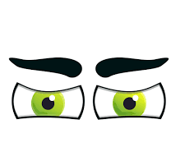
Face - Gaze
Directed-gaze face: Capture attention
Averted-gaze face: Direct attention

Slide 7
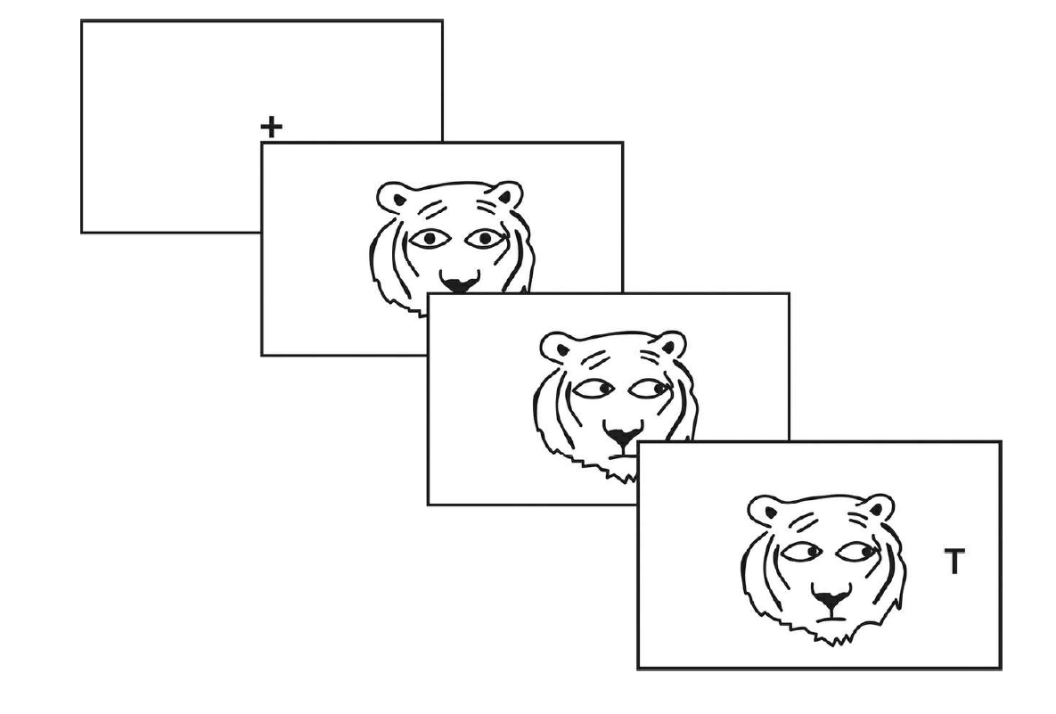
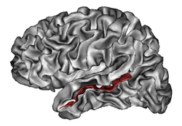
Social attention Stroop task
Attention biased by averted-gaze
Superior temporal sulcus

Slide 8
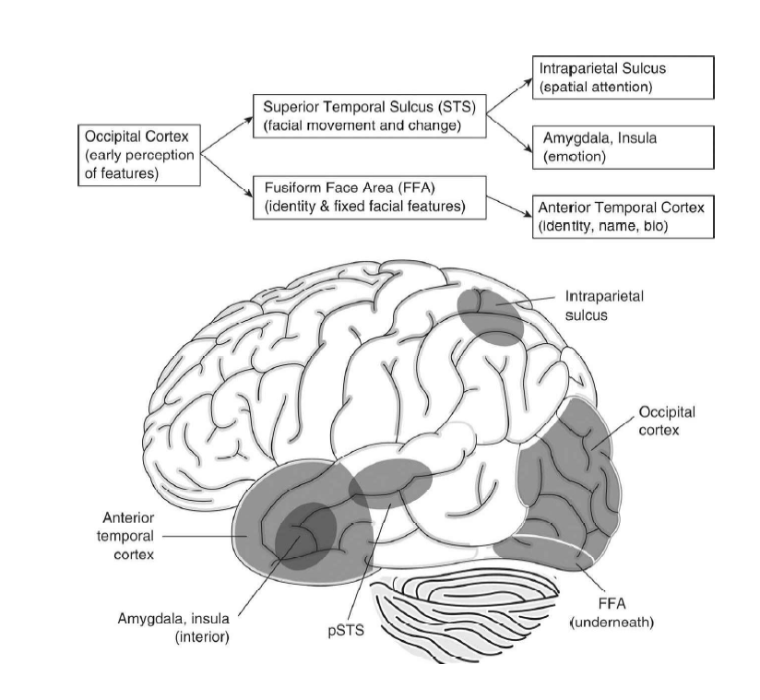
Face – Face perception
Face perception as a global mental process !
Right hemisphere:
Identification/ Individualization/Person-based
Left hemisphere:
Categorization/ Global/ Abstract
Lateralization
Haxby, J. V., Hoffman, E. A., & Gobbini, M. I. (2000). TICS

Slide 9
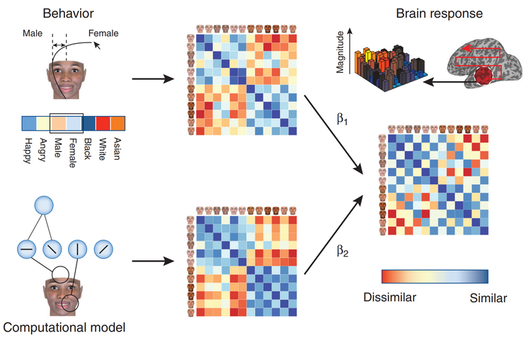
Face – Face perception
Stolier, R. M., & Freeman, J. B. (2016). Nat. Neurosci

Slide 10
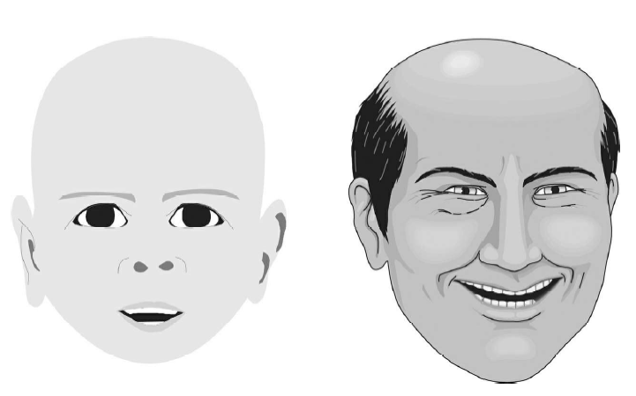
Baby faces?
Why do we expect people with baby-faced features to have equally innocent personalities ?

Slide 11
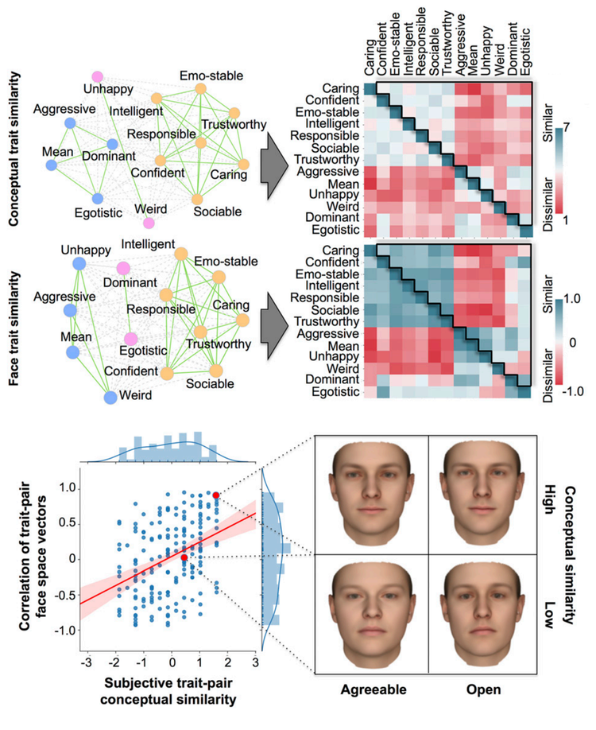

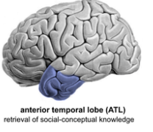
Spontaneous inferences from faces
Facial features/ Emotion
Personality traits
Encoding
Stolier, R. M., et al.. (2018). PNAS

Slide 12
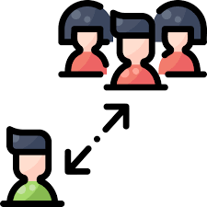
Salience
Perceptual features
Physical position
Sheer visual exposure
Concrete:
Expectancy
Norms
Social relationship
Kinship
Abstract:
Beyond face perception, what attracts our attention?

Slide 13
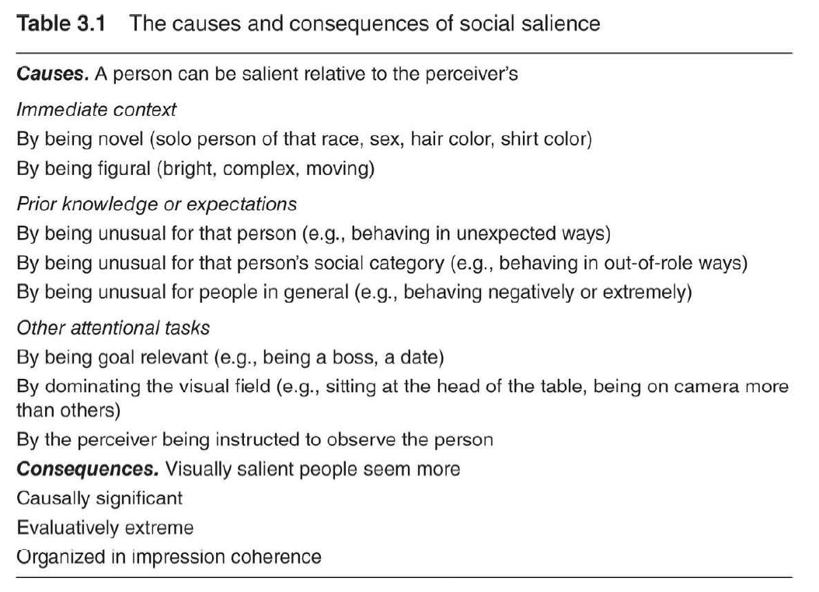

Slide 14

Salience-causality principle
Salience exaggerates causal judgements in the direction implied by prior knowledge
Salience exaggerates extreme evaluations
Salience organizes impressions
Relevant recall
Accessibility
Perceived Salience
Social
judgement
Salience as “catalyst”

Slide 15
Vividness
Emotionally interesting
Concrete and imagery-provoking
Proximate in a sensory, temporal or spatial way
However, little empirical evidence support that vividness influence social cognition and behaviors !!!
One major exception: Individual case history

Slide 16
Accessibility
Definition: Readiness which stored knowledge can be used
Personality trait
Assimilation
Race
Social norm
Gender/ Gender-role
Affect
Motivation
Contrast

Slide 17
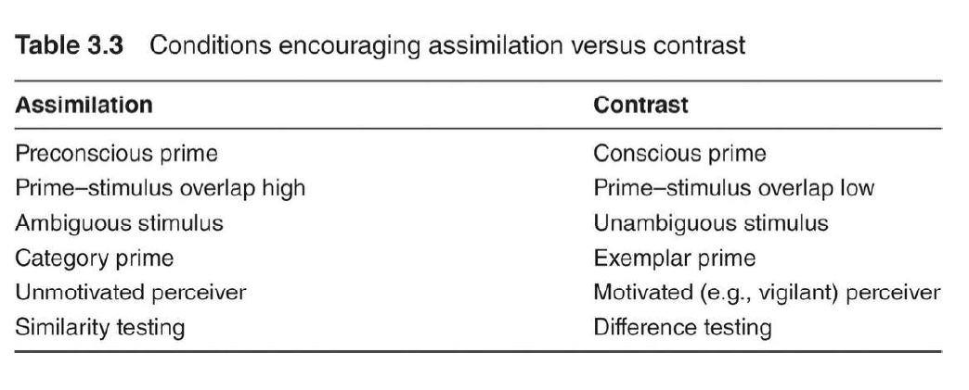

Slide 18
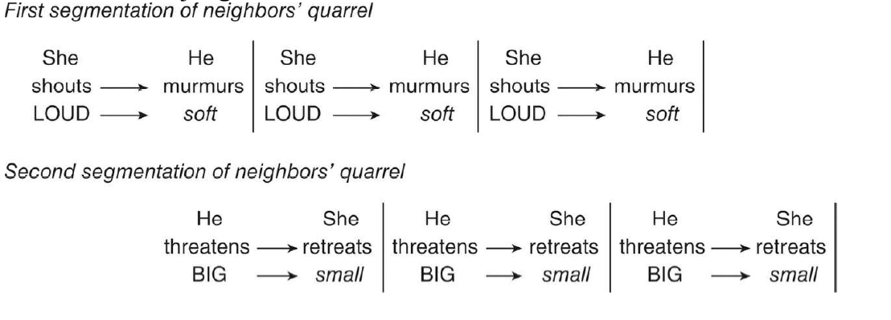
Direct perception

Slide 19
Take home message
Faces as the dominant salient social stimulus
Spontaneous inference during face perception
Gaze capture attention
Salient and vivid stimuli capture attention
Attention orient to primed stimuli

Slide 20


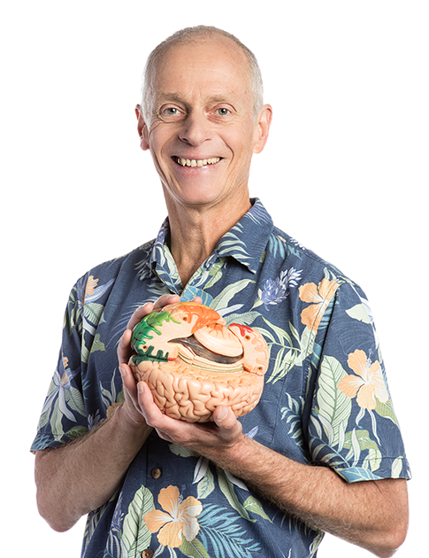

Experts in this topic
James Haxby
Nancy Kanwisher
Ralph Adolphs
Jon Freeman

Slide 21
References
Haxby, J. V., Hoffman, E. A., & Gobbini, M. I. (2000). The distributed human neural system for face perception. Trends in cognitive sciences, 4(6), 223-233.
Stolier, R. M., Hehman, E., Keller, M. D., Walker, M., & Freeman, J. B. (2018). The conceptual structure of face impressions. Proceedings of the National Academy of Sciences, 115(37), 9210-9215.
Freeman, J. B., Stolier, R. M., Brooks, J. A., & Stillerman, B. S. (2018). The neural representational geometry of social perception. Current opinion in psychology, 24, 83-91.
Stolier, R. M., & Freeman, J. B. (2017). A neural mechanism of social categorization. Journal of Neuroscience, 37(23), 5711-5721.
Stolier, R. M., & Freeman, J. B. (2016). Neural pattern similarity reveals the inherent intersection of social categories. Nature neuroscience, 19(6), 795-797.

Slide 22
Thanks for listening!

